Slide 1
Application Acceleration
with High-Level Synthesis
高階合成技術於應用加速
Team 06
Message Communication
Speaker: 王景平 / 黃其澤
Advisor: Prof. Jiin Lai
Date: 2022/12/29

Slide 2
Outline
Project Goal
Background
Implementation
QOI
Polar Code
Simulated Channel (AWGN)
Results
Analysis

Slide 3
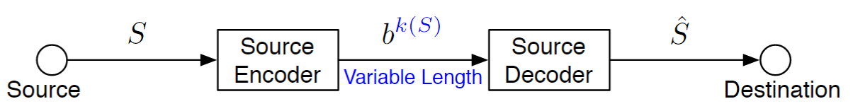
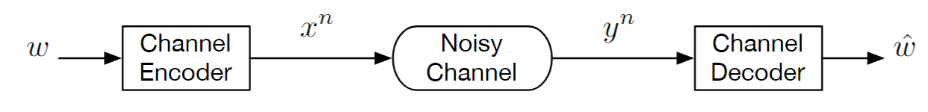
Project Goal
End-to-End On Board
Lossless Message Compression
Delivering Information Reliably
Target: Full run including Encoding, Channel Simulation, and Decoding
Source Coding
Reduce the latency and energy of transmitting
QOI (Image)
Channel Coding (Error Correction Code)
Reliable information transmission
Polar Code
Noisy Channel
BPSK Modulation
Simulated AWGN Channel

Slide 4
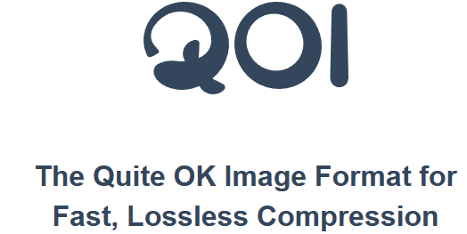

Background
Source Coding
Channel
Coding
The Quite OK Image Format (QOI) is a specification for lossless image compression of 24-bit (8 bits per color RGB)
First announced on November 24th 2021
Create an open source, faster, lossless compression method than PNG
20–50x faster encoding, and 3–4x faster decoding speed compared to PNG

Slide 5
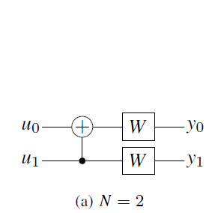
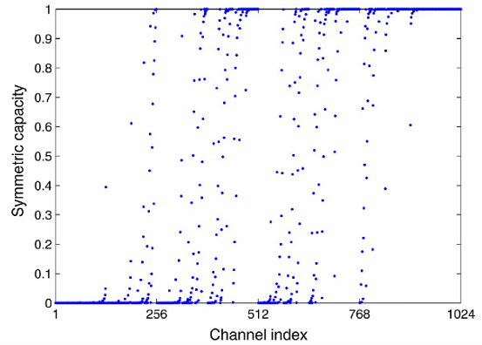
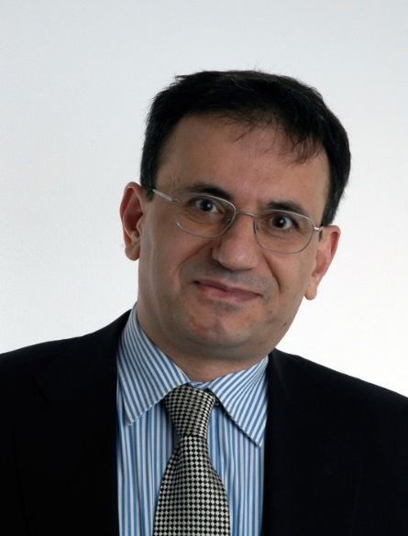
Background
Source Coding
Channel
Coding
Polar code is a kind linear block error-correcting code
Distribute the some part of channel capacity to others by polar transform
Transmit frozen message on low reliability channels to protect the information on high reliability channel
Proposed on 2008 by Arikan
First code with explicit construction to provably achieve the channel capacity
Polar Transform
Channel Polarization

Slide 6
QOI
Source Coding
Channel
Coding
Lightweight Image Compression Format

Slide 7
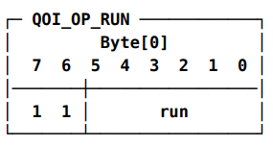
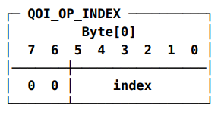
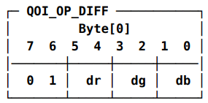
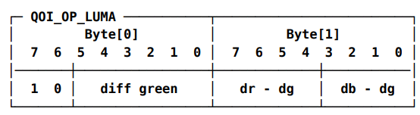
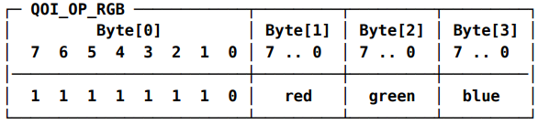
Spec
Source Coding
Channel
Coding
5 cases
RUN(same as previous one)
INDEX(seen previously)
DIFF(difference less than 2)
LUMA(difference less than 32/8)
RGB(default fallback)
Must be processed in sequential order
Output based on previous pixel
Indefinite length of output

Slide 8
Polar Code
Source Coding
Channel
Coding
Error correction code

Slide 9
Polar Encoding
Source Coding
Channel
Coding
Polar Encoder
Frozen Bit
Insertion
Matrix
Multiplication
Bit
Reversal
Frozen bit insertion inserts zeros to more worse channel
Reduce the influence of noise in synthetic channel
Matrix Multiplication
Encode the message through multiplying with generator matrix
Bit Reversal
Reverse the bit channel order to fit encoding sequence

Slide 10
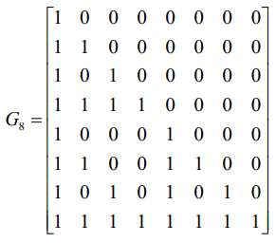
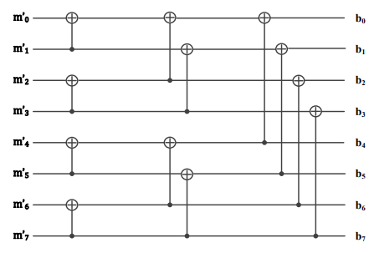
Matrix Multiplication
Source Coding
Channel
Coding
Multiply the message with generator matrix and exchange those with bit reversal order
Aggregate information on high reliability channel to low reliability channel
Low reliability channels are frozen, the message on it is ensured to be 0
Frozen Bit
Insertion
Bit
Reversal
Kronecker power of polar transform
Matrix Multiplication
Code Rate = 1/2

Slide 11

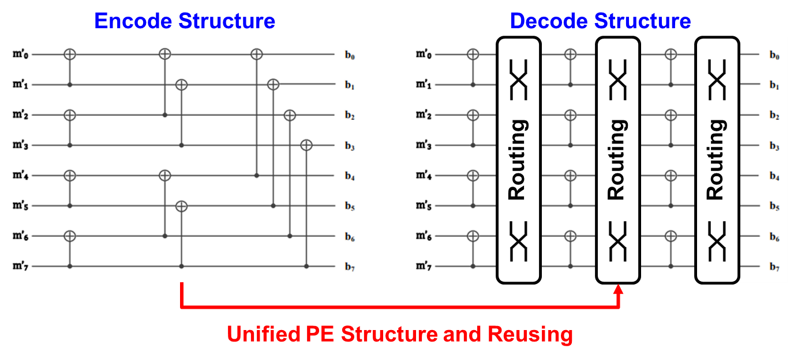
Polar Decoder
Source Coding
Channel
Coding
Polar Decoder
PE
Array
Routing
PE
Array
…
Encode Structure
Decode Structure
Routing
Routing
Routing
Unified PE Structure and Reusing

Slide 12
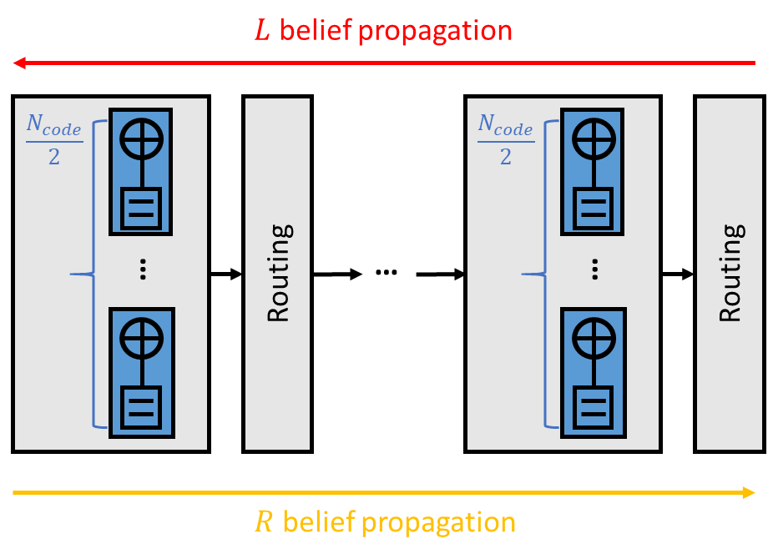
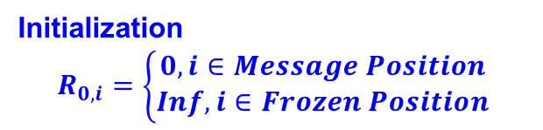
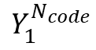
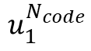
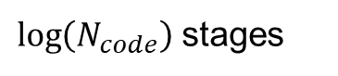
Belief Propagation
* LLR: Log Likelihood Ratio
Source Coding
Channel
Coding
Parallel compute LLR between every stage by propagate belief
Prior- Knowledge ( Reliability Sequence & Receive LLR )
$\log\left(N_{code}\right)$ stages
LLR
LLR
Transmit Message
Receive Message
$$u_{1}^{N_{code}}$$
$$Y_{1}^{N_{code}}$$
Initialization
$$R_{0,i}=\left\{\begin{aligned}0, i∈Message Position \\ Inf, i∈Frozen Position\end{aligned}\right.$$
1 Iteration = R + L Belief Propagation
Notes:
10 / 1

Slide 13
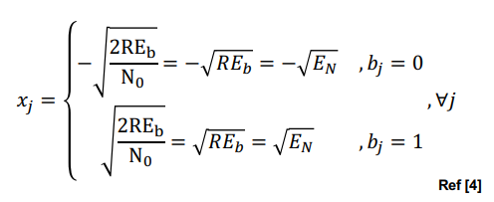
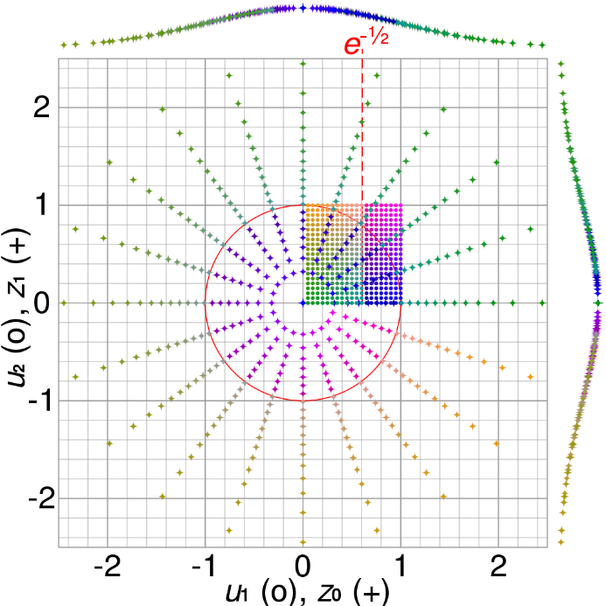
Modulation & AWGN Channel
BPSK modulation
AWGN
Box-Muller Transform
Conversion
Uniform Distribution → Gaussian Distribution
dst_noise[i] =
(1-2*(float) dst[i]) * SNR + noise;

Slide 14
Problem Encountered
hls::stream causes cosim hanging
With/without dataflow
pragma HLS STREAM failed due to memory limitation to csim
Use array buffer with pragma HLS STREAM implies FIFO in synthesis, but a relative large array in csim, which exceed the memory limitation and cause segmentation fault
Image size is forced to reduced to 32 x 32 x 3
Even array buffer with pragma HLS STREAM causes cosim hanging
Some code in the design may not fit well in FIFO design
Warning: OPMODE Input Warning: The OPMDOE 0110x0x …
Can be ignored, but occupies console output and causes slow cosim
Skip cosim, export RTL directly

Slide 15
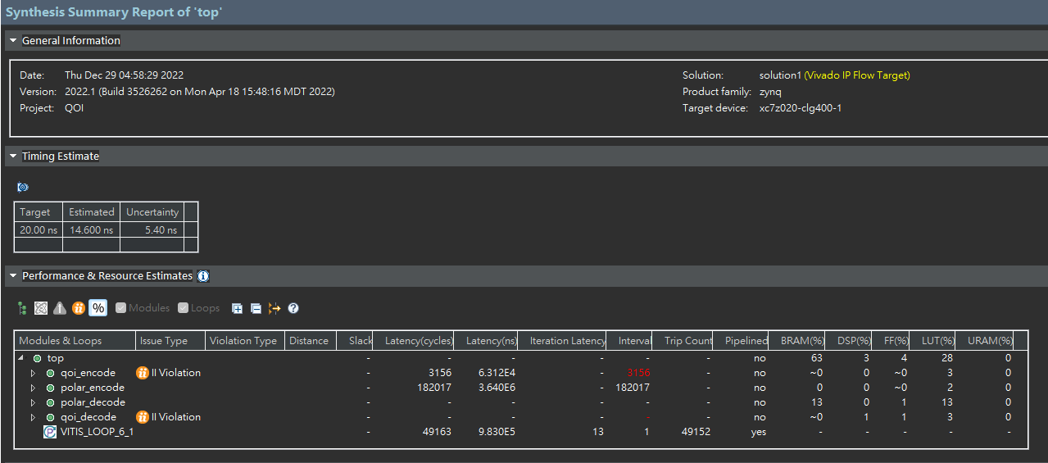
Result
Due to the previous issue, no much optimization is performed
Many improvements available
FIFO design
Dataflow
Array partition
Loop unrolling

Slide 16
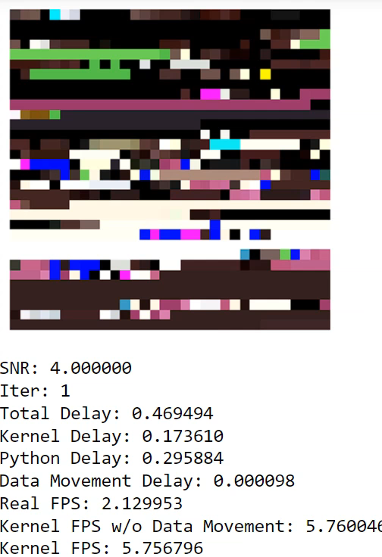
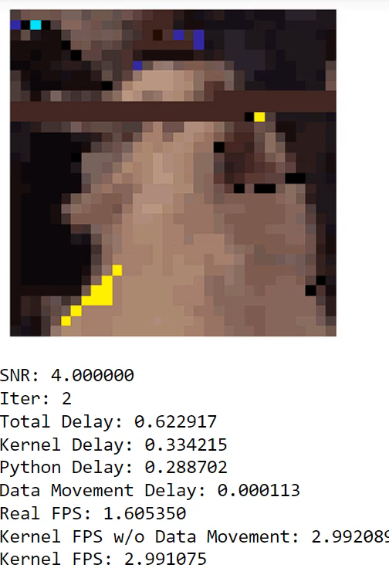
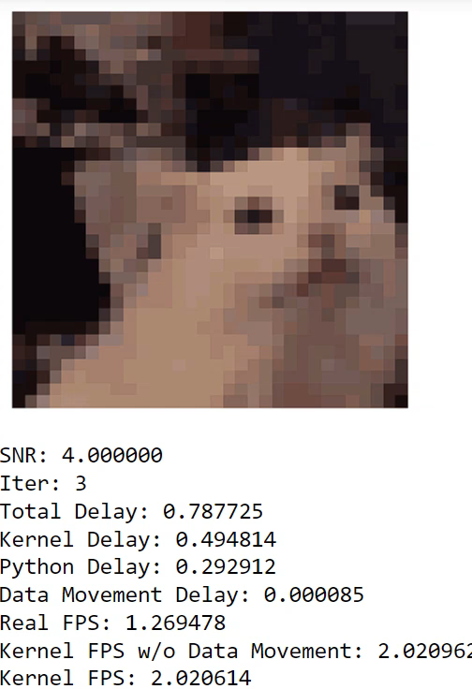
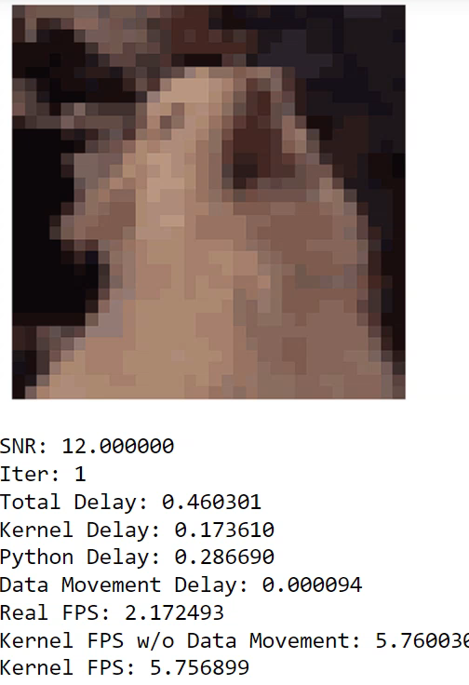
DEMO
An image passes through QOI encoding, Polar encoding, AWGN channel simulation, Polar decoding, QOI decoding, and print on the screen (PYNQ)
SNR, iteration are configurable

Slide 17
Reference
[1] https://qoiformat.org/
[2] E. Arkan, " Channel polarization: A method for constructing capacity achieving codes for symmetric binary-input memoryless channels,'' IEEE Trans. Inf. Theory, vol. 55, no. 7, pp. 30513073, Jul. 2009.
[3] E. Arýkan, " Polar codes: A pipelined implementation,'' in Proc. 4th Int. Symp. Broadband Commun. (ISBC), Jul. 2010, pp. 1114.
[4] Yu, Yongrun, et al. "Belief propagation bit-flip decoder for polar codes." IEEE Access 7 (2019): 10937-10946.
[5] Y. Shen, W. Song, Y. Ren, H. Ji, X. You and C. Zhang, "Enhanced Belief Propagation Decoder for 5G Polar Codes With Bit-Flipping," in IEEE Transactions on Circuits and Systems II: Express Briefs, vol. 67, no. 5, pp. 901-905, May 2020

Slide 18
Decoding Structure
Source Coding
Channel
Coding
Decompose the encode structure into routing and PE array
Reuse PE array by pre-defined routing matrix.
Encode Structure
Decode Structure
Routing
Routing
Routing
Unified PE Structure and Reusing / Shared Memory

